Slide 1
Redemption in Cloudburst over Nebraska? Love, Gender, and Age on the Road in Contemporary Film
Leni Marshall, UW-Stout
November 22, 2015

Slide 2
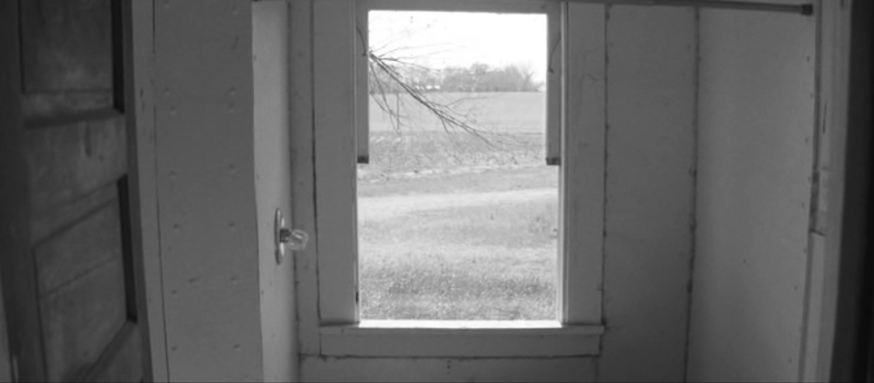
Setting: Nebraska

Slide 3
People: Nebraska, with Panavision C-Series Anamorphic Lenses

Slide 4
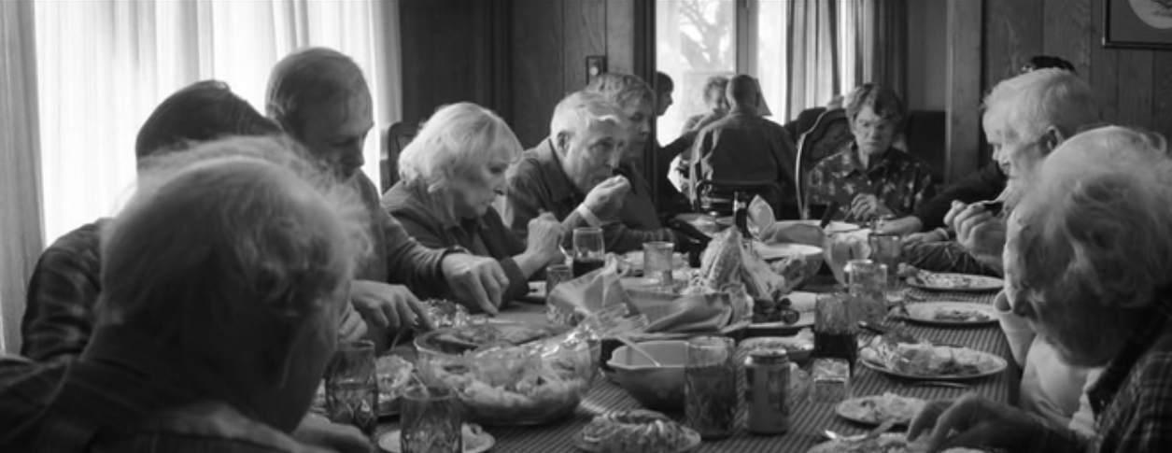
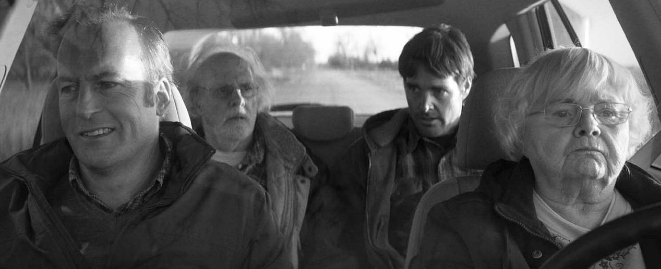
People: Nebraska

Slide 5
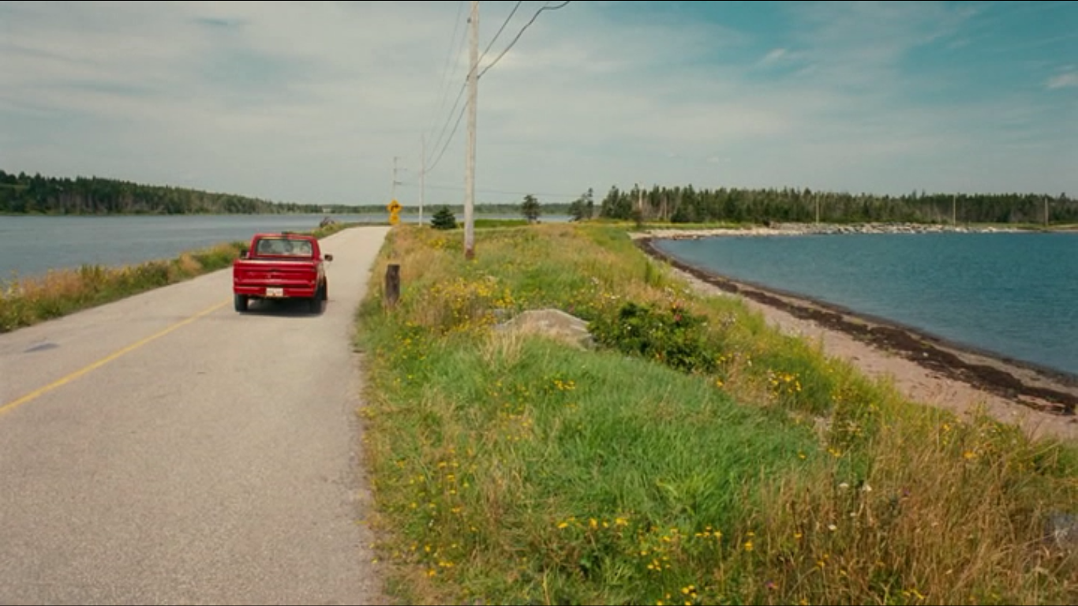
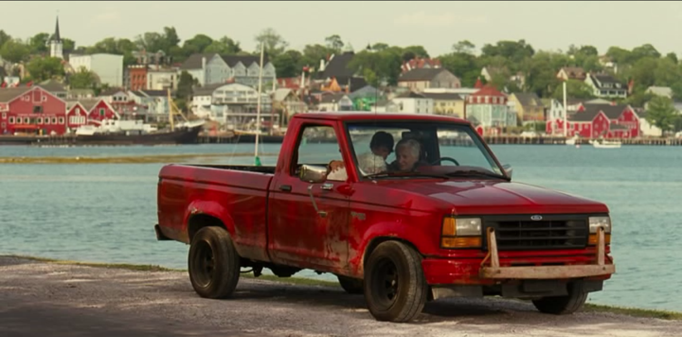
Setting: Cloudburst

Slide 6
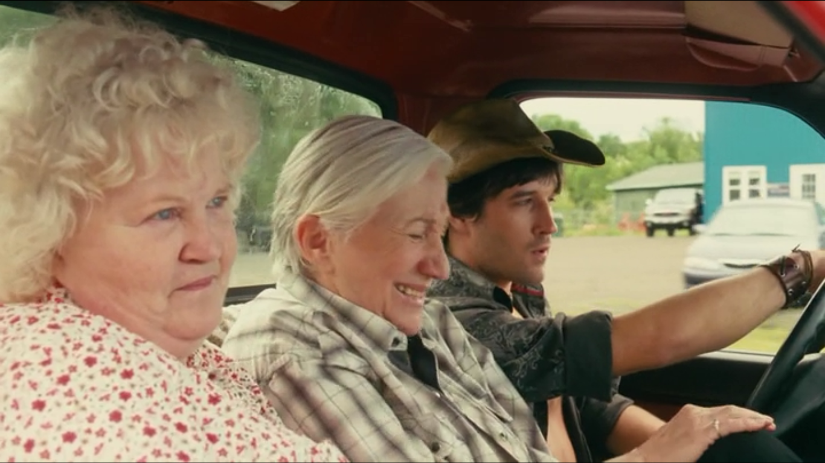
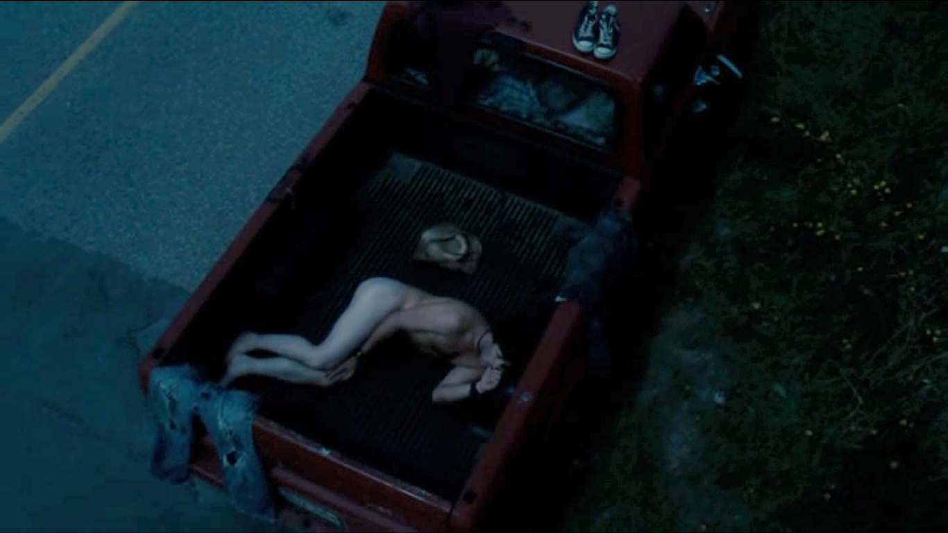
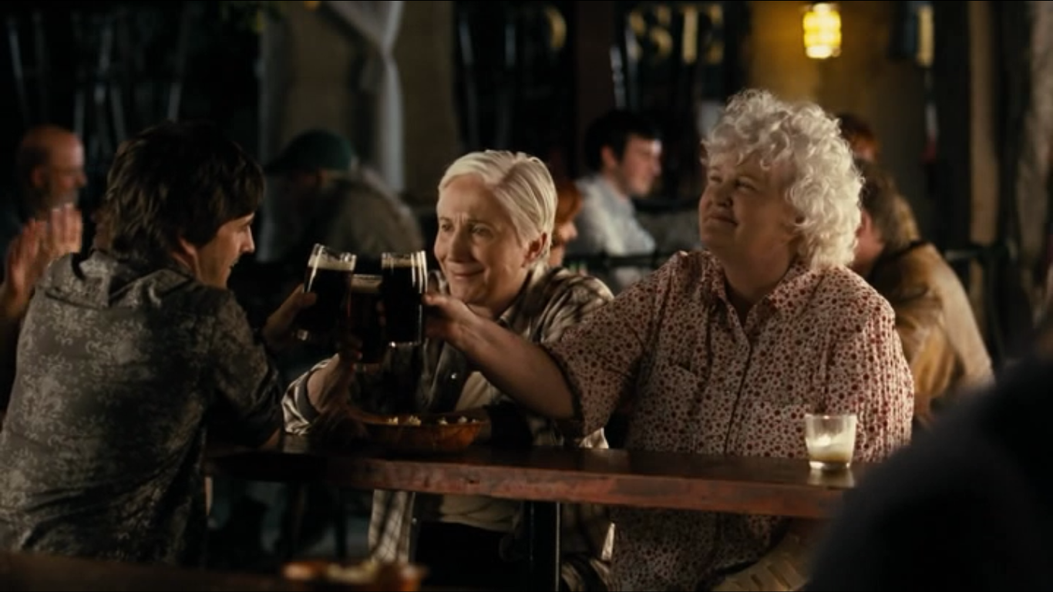
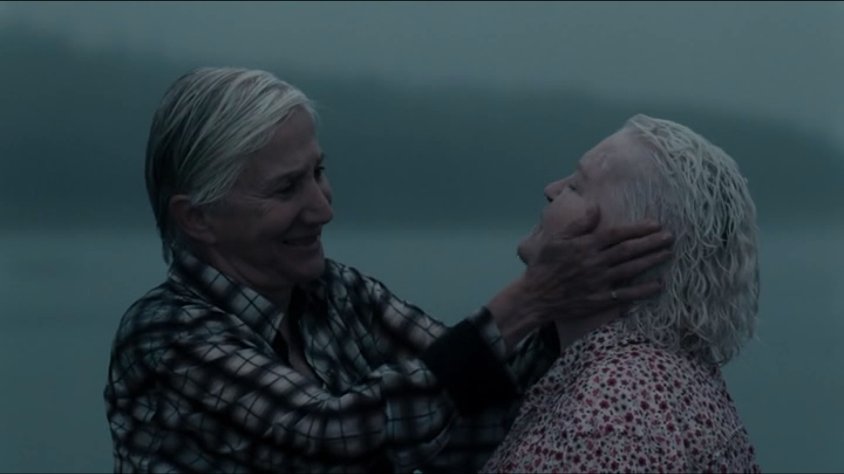
People: Cloudburst

Slide 7
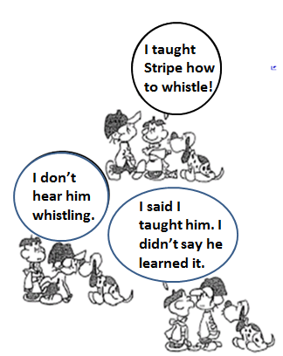
GSA Humanities & Arts: Still Breaking Ground
Leni Marshall, Ph.D.
leni@agingstudies.org

